Slide 1
Upcycling agri-food by-product with phototrophic purple bacteria
Baptiste Leroy
Proteomic and Microbiology, Research institute for Biosciences, UMONS, Belgium
PurpleTech, Spin-Off company (in creation)

Slide 2
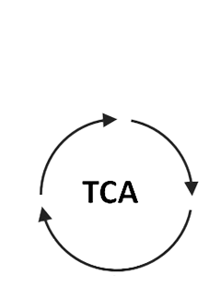
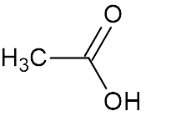
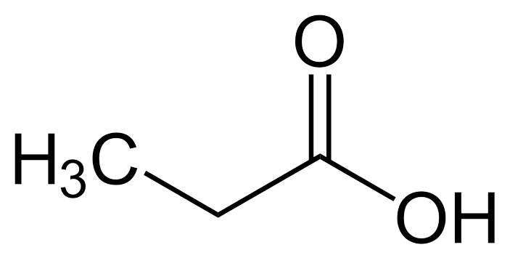
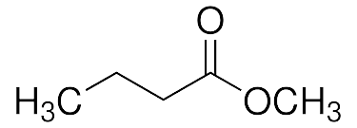

PPB for industry byproduct valorisation
Substrates
Metabolism
macromolecules
C₂
C₃
Amino acids
Nucleic acids
Lipids
vitamins
…
Acetate
Propionate
Biomass
& products
C₄
Butyrate

Slide 3
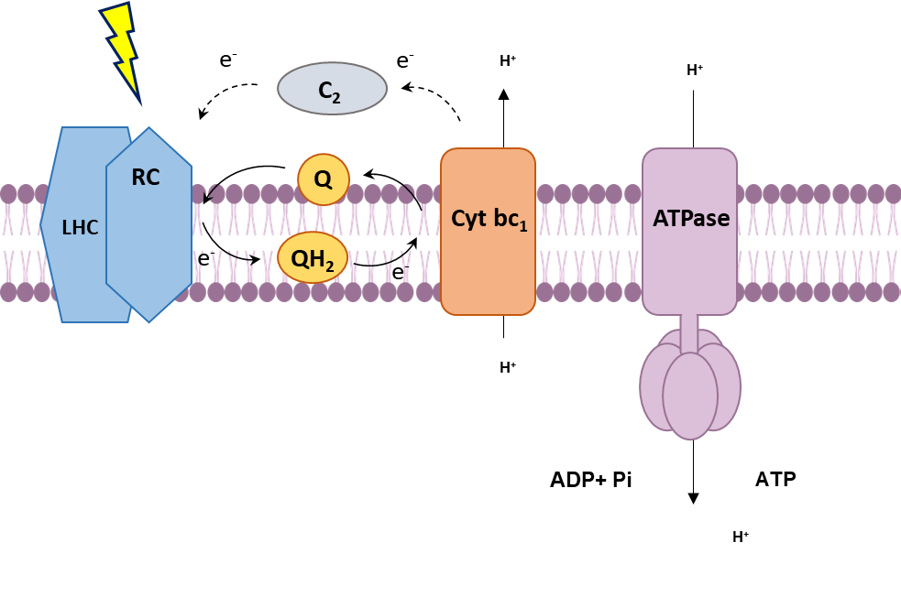
Light utilization in PPB

Slide 4
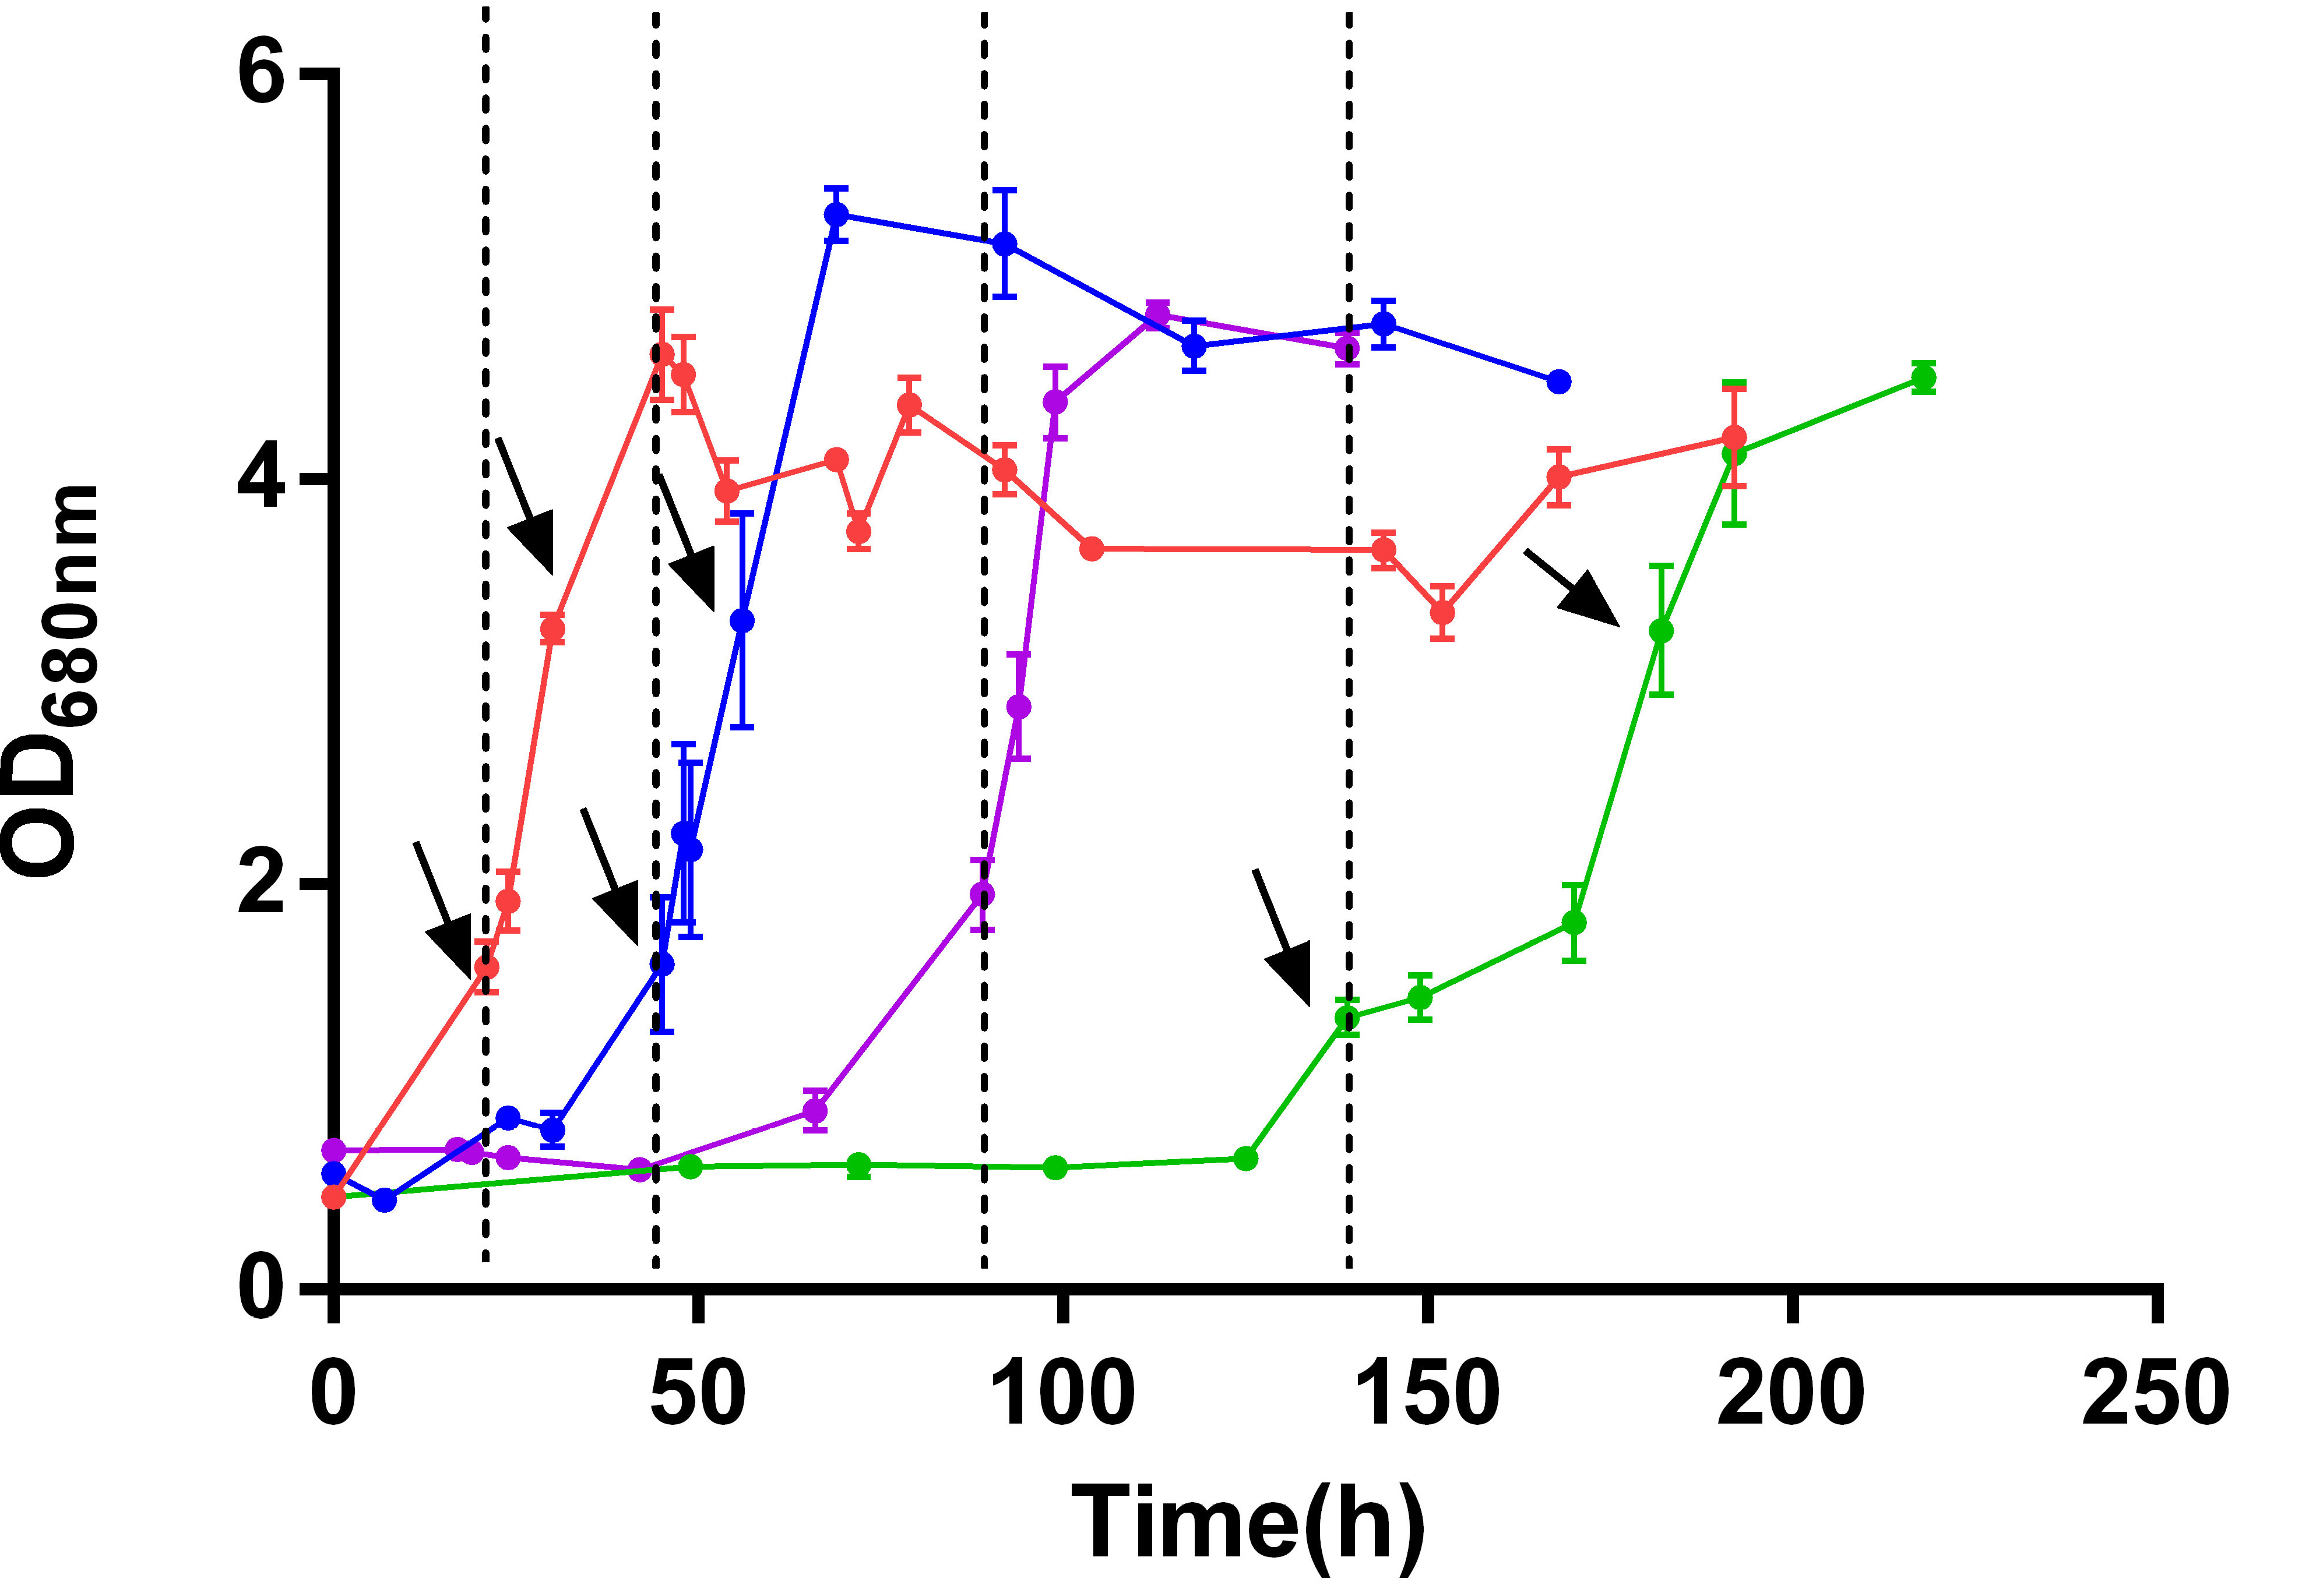
Light stress response in Rs. rubrum
published: 25 March 2020
doi: 10.3389/fmicb.2020.00464

Slide 5
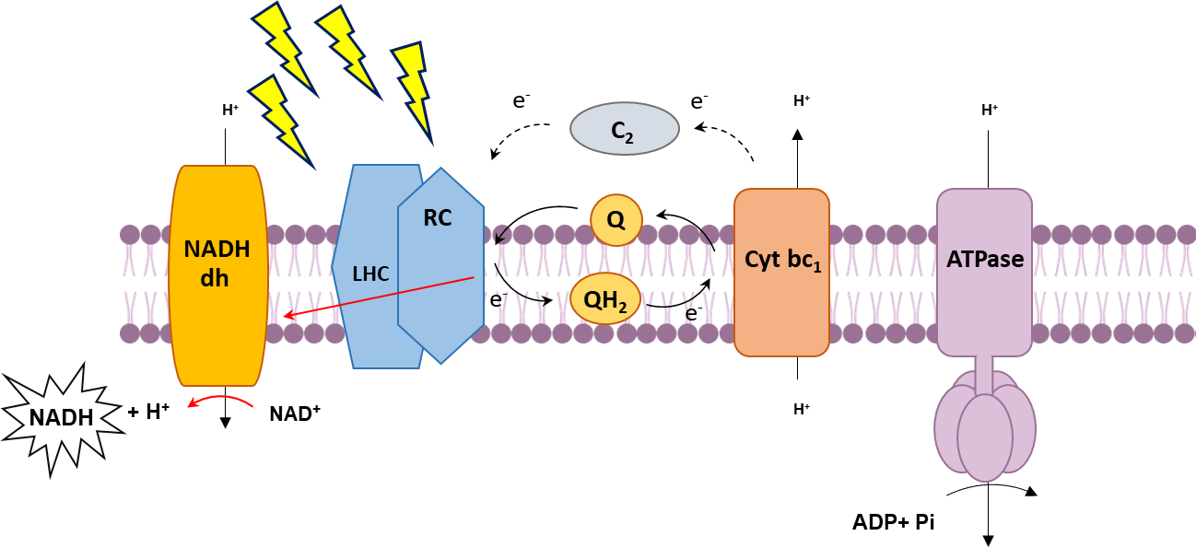
Light stress in PPB – photoreduction of NAD+

Slide 6


PPB for industry byproduct valorisation
Substrates
Metabolism
macromolecules
C₂
C₃
Amino acids
Nucleic acids
Lipids
vitamins
…
Acetate
Propionate
Biomass
& products
C₄
Butyrate
Redox imbalance
e- sink
PHA
Hydrogène
…
NADH
Bioindustry

Slide 7
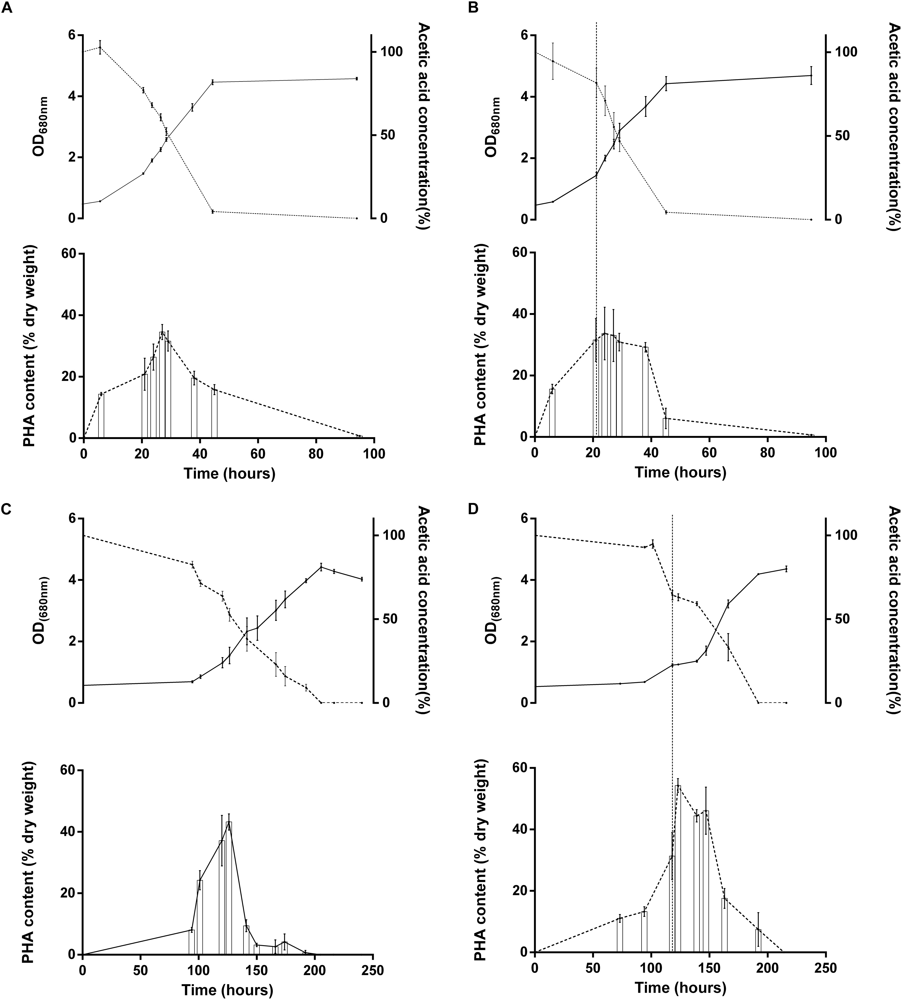
Light stress response in Rs. rubrum
published: 25 March 2020
doi: 10.3389/fmicb.2020.00464

Slide 8
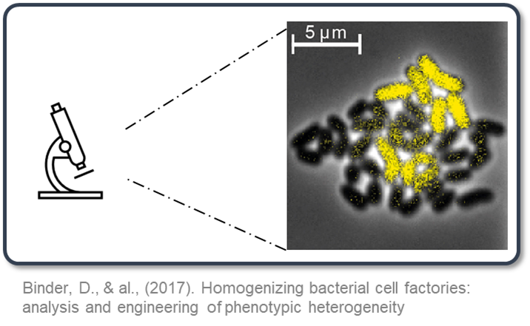
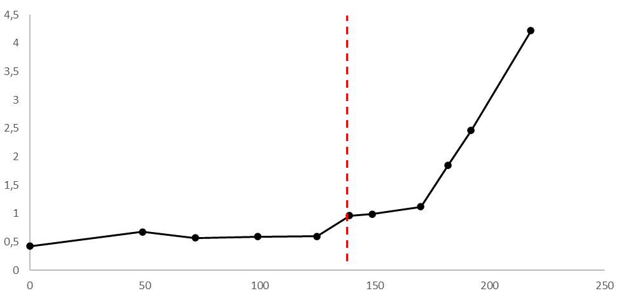
Response to light stress and metabolic heterogeneity
Do pure cultures really exist?

Slide 9
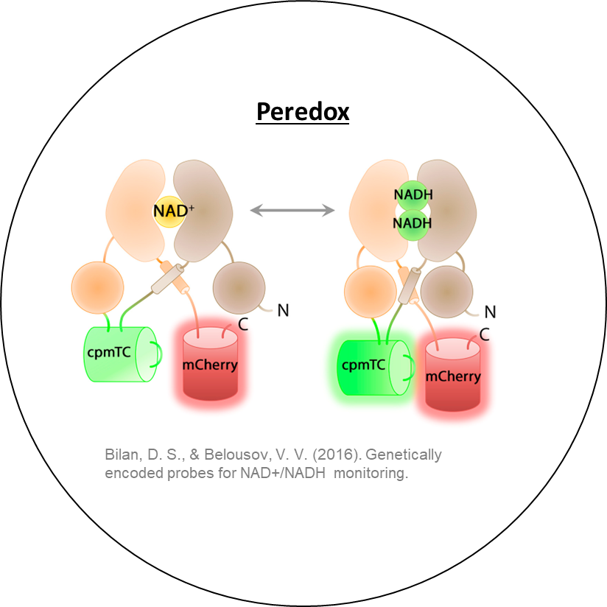
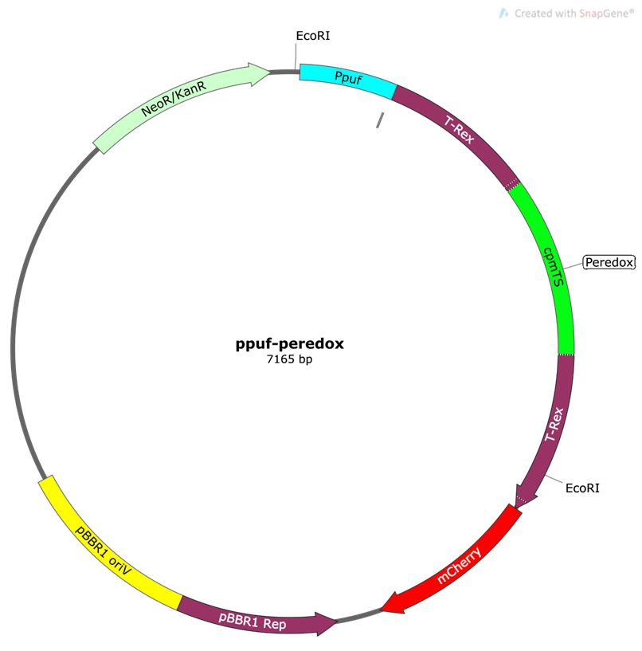
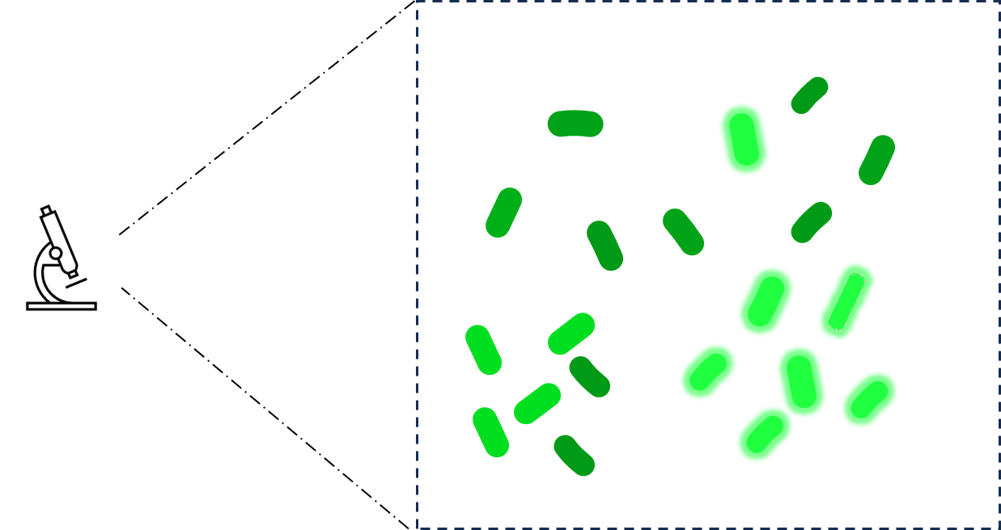
Response to light stress and metabolic heterogeneity
Metabolic heterogeneity

Slide 10
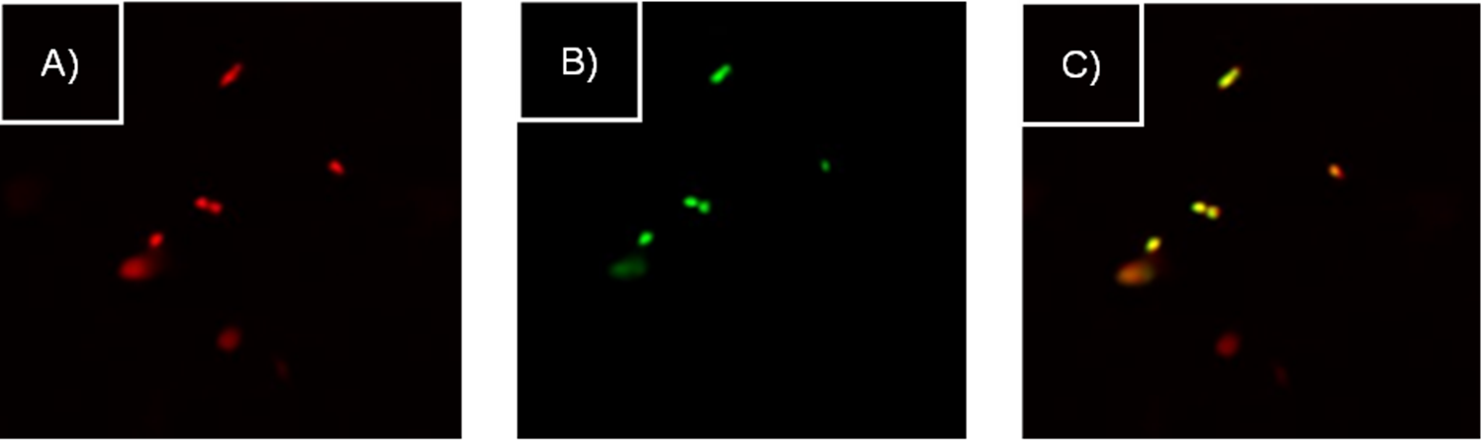
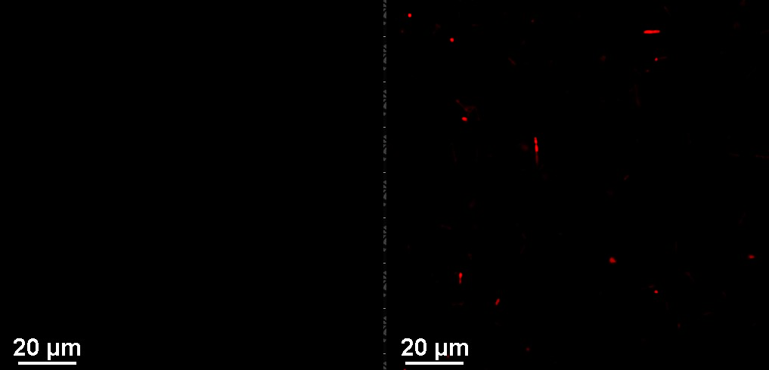
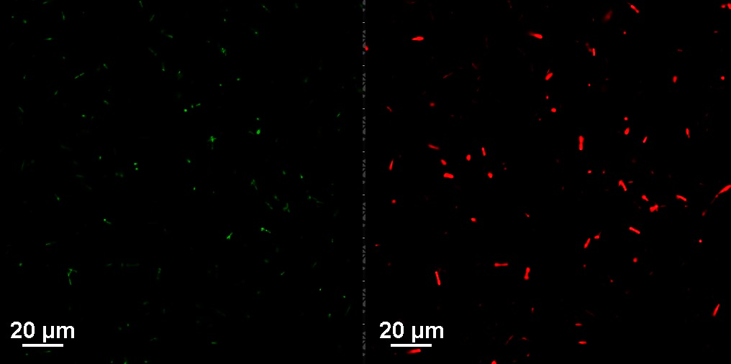
Response to light stress and metabolic heterogeneity
Metabolic heterogeneity
Aerobic cultivation of Rs. rubrum
Anaerobic cultivation of Rs. rubrum
Green
Red

Slide 11

Upcycling agri-food byproduct?
Production of microbial proteins
Food/feed supplement

Slide 12
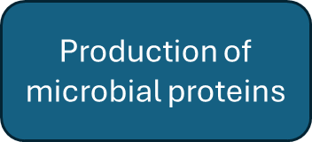
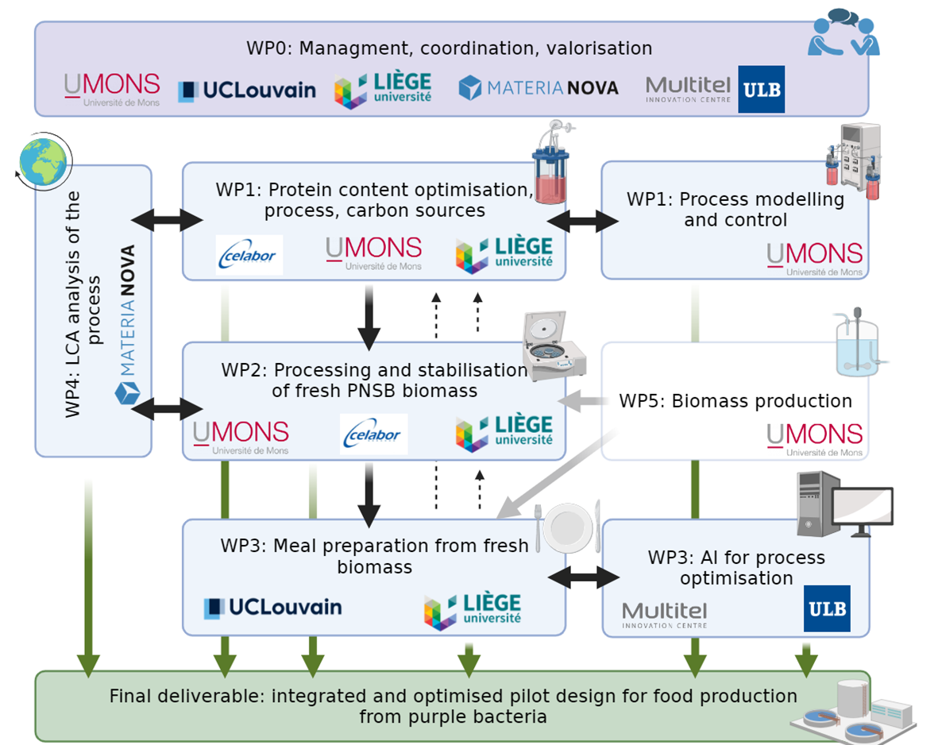



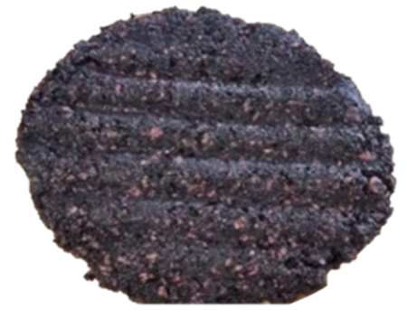
Upcycling agri-food byproduct?

Slide 13

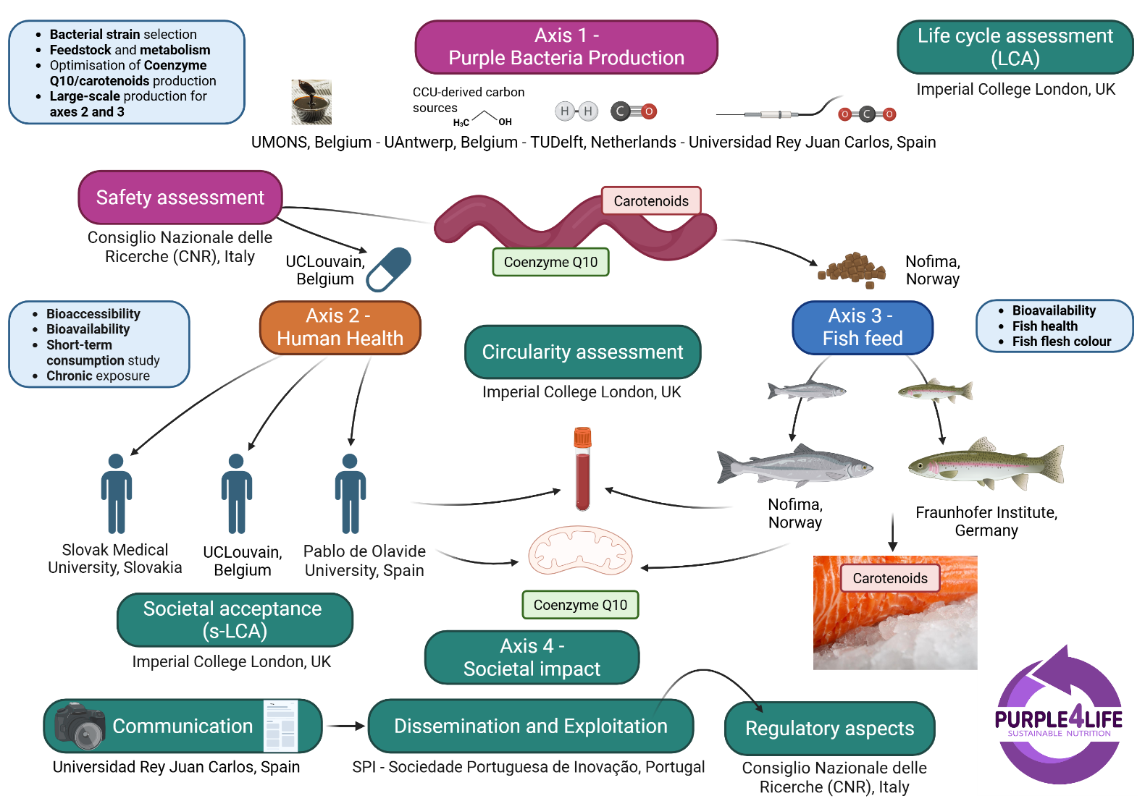


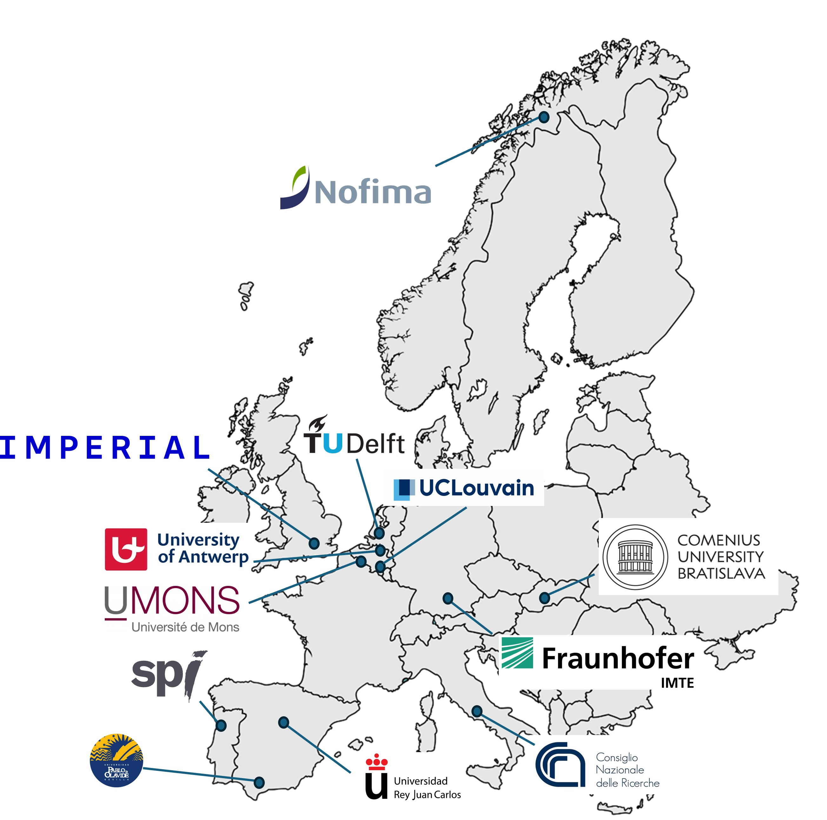
Upcycling agri-food byproduct?

Slide 14
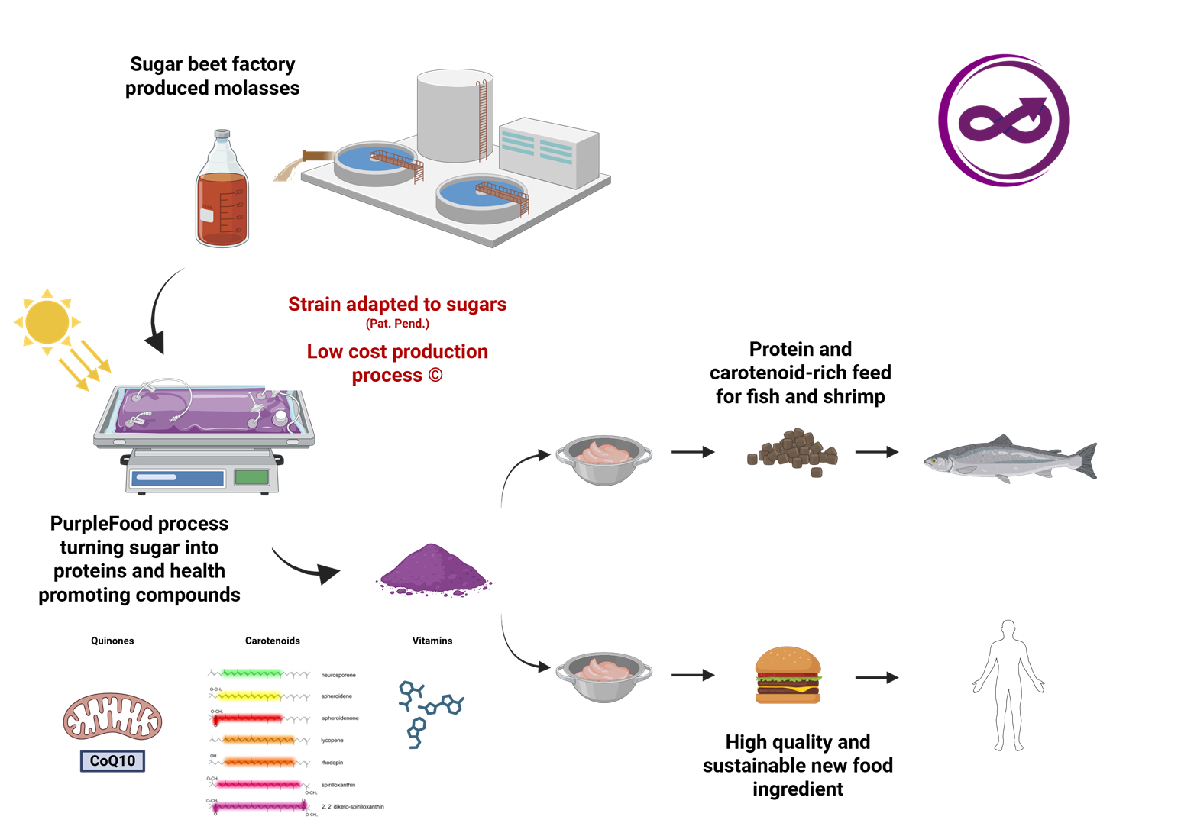
Upcycling agri-food byproduct?

Slide 15


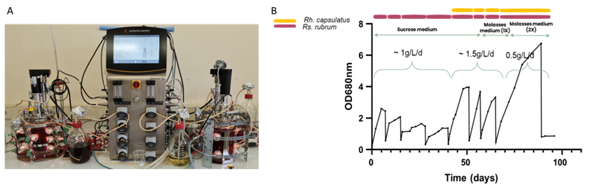
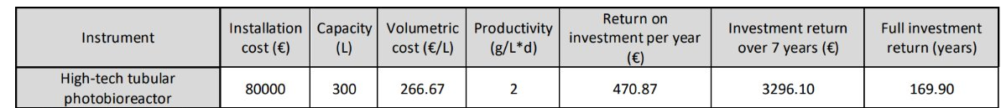
Upcycling agri-food: the process (cost) matters?
Feasability study (esa; UAntwerpen)

Slide 16
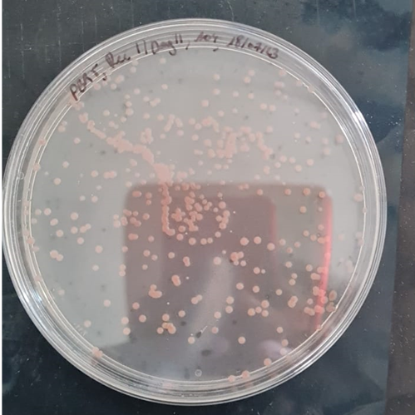
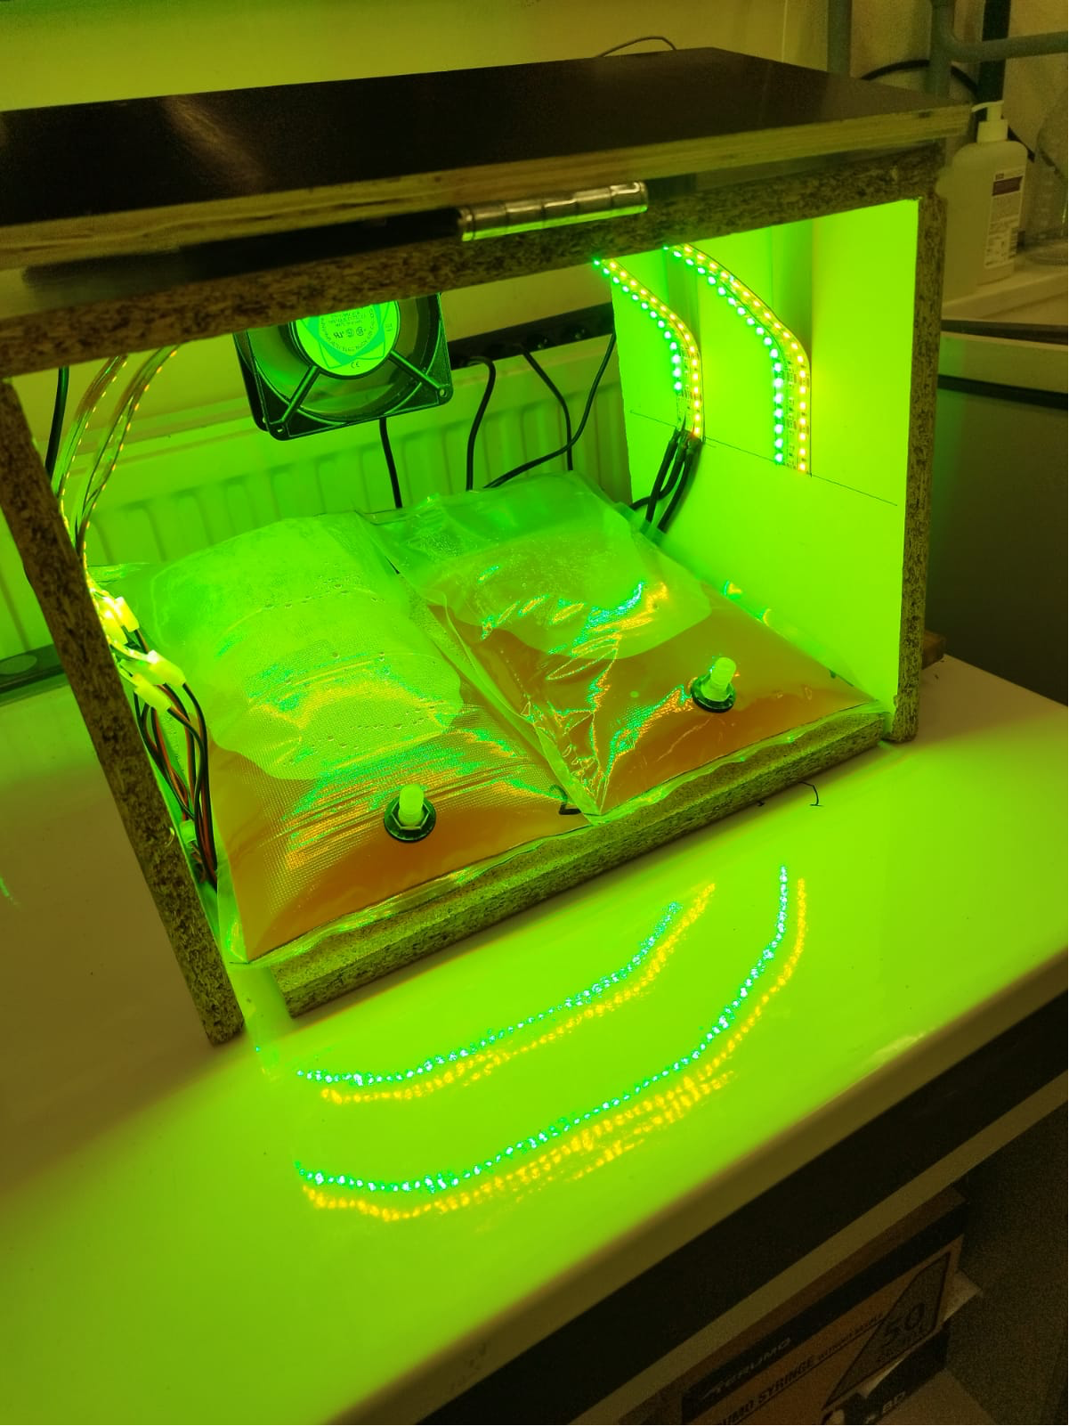
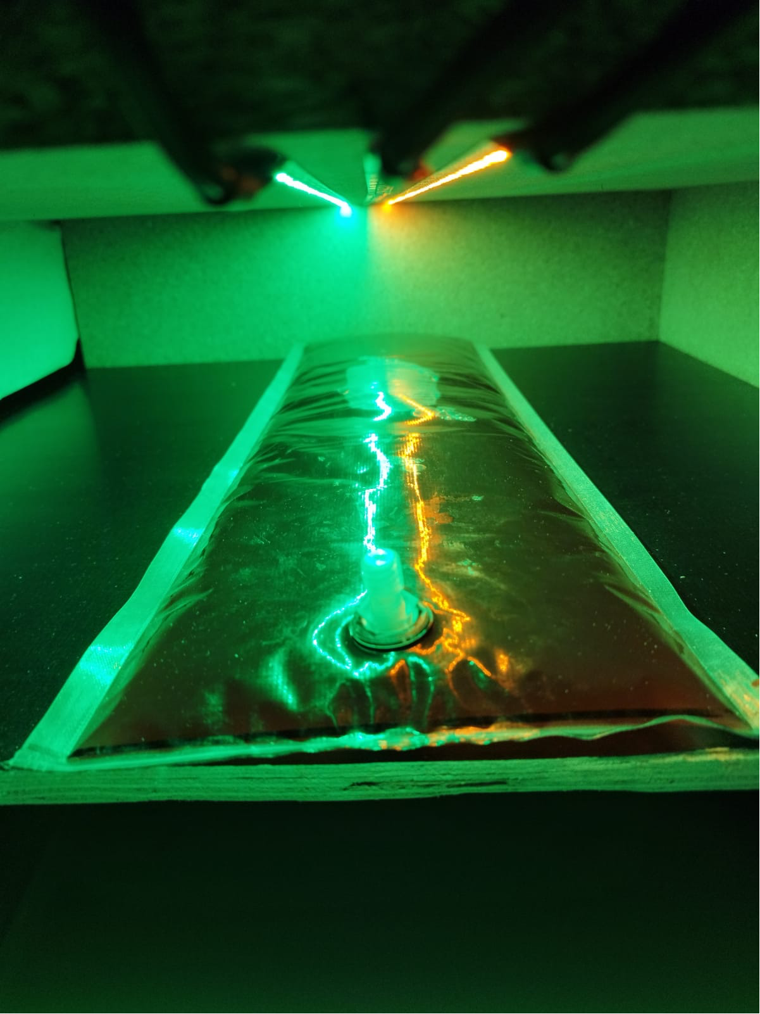
Development of low cost production facility
low-cost reactors testing and scaling up
Axenicity maintained in low-cost reactors!

Slide 17
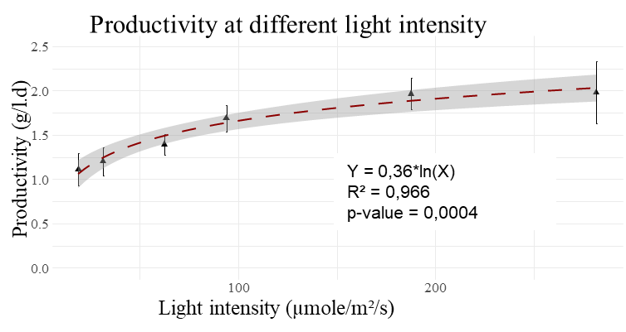
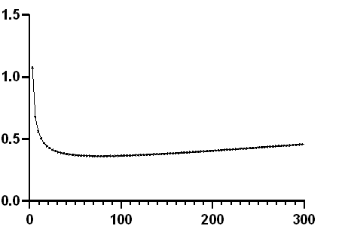
Optimisation of lighting system
Electricity consumption per gram of biomass (kWh/gr (dw))
Light intensity (µmol/m².sec)

Slide 18
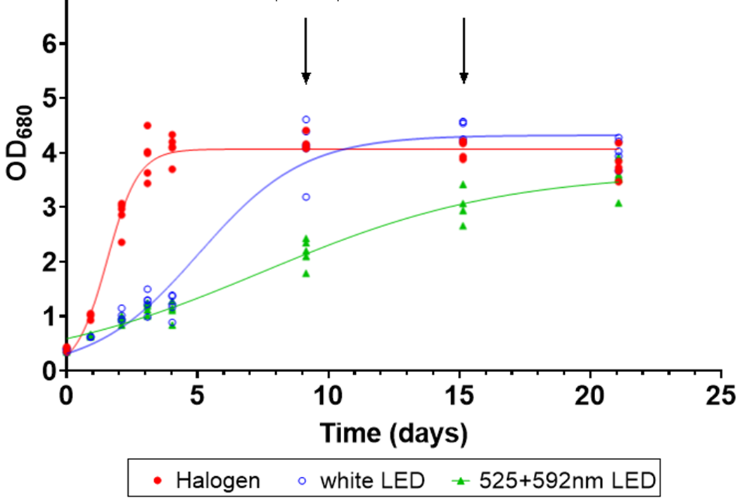
Optimisation of lighting system
Halogen vs LEDs

Slide 19
Take home message
PPB are very good candidate for development of circular, biobased economy
Upcycling should always be prioritised when possible
PPB are promising organisms for the development of innovative health promoting new feed/food ingredients
Low-cost reactor can be used for food quality PPB production
Light utilisation is key in the development of economically viable processes
Effort are still needed to increase LEDs based lighting systems

Slide 20







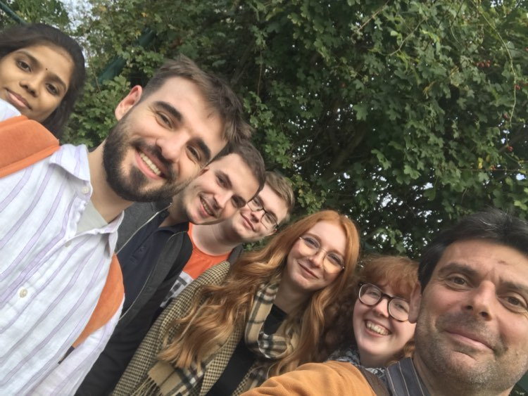




Thank you for your attention
Guillaume Bayon-Vicente
Laura Toubeau
Manon Gilson
Vittorio Olivieri
Simone Krings
Abdessalem Agoudjil
Ruddy Wattiez
Siegfried Vlaeminck
Abbas Alloul
Naïm Blansaer
Luis Diaz Allegue
Dorothée Goffin
Mathieu De Rijdt
Jeanne Verhaegen

